Slide 1
Day 02 - Memory & Performance
How memory layout affects our code
09/05/25

Slide 2
Overview
We’ll cover:
How computers carry out instructions
How memory is organized across a computer
How data moves through a computer
With computers, there’s always more detail and caveats you can dive into.
We’ll keep this at a moderate level of detail.
Notes:
Data movement and access is a recurring theme

Slide 3
von Neumann Architecture
The design framework used by most modern computers
Memory stores both program instructions and data
Processing unit executes instructions on the data
Processing cycle:
Fetch data
Execute instructions
Store result data

Slide 4
Processing Cycle
Example:
c = a + b
Fetch (load) the value of a
Fetch the value of b
Execute “add” operation on a and b
Store the result to the variable c

Slide 5
Processing Cycle
Main Memory
Central Processing Unit
Here’s your instructions
Instructions:
c = a + b
Control Unit (CU)
What are my instructions?
Registers
Data:
a b
c = a + b
Notes:
Remember the von Neumann architecture
Registers are smallest memory

Slide 6
Processing Cycle - Fetch
Main Memory
Central Processing Unit
Ok, here’s a
Instructions:
c = a + b
Control Unit (CU)
I need to fetch a
Registers
Data:
a b
c = a + b
a

Slide 7
Processing Cycle - Fetch
Main Memory
Central Processing Unit
Instructions:
c = a + b
Control Unit (CU)
Also I need b
Registers
Data:
a b
c = a + b
a
b

Slide 8
Processing Cycle - Execute
Main Memory
Time to add
Central Processing Unit
Instructions:
c = a + b
Control Unit (CU)
Arithmetic Logic Unit (ALU)
Registers
Data:
a b
c = a + b
a
b

Slide 9
Processing Cycle - Store
Main Memory
Here’s the result
Central Processing Unit
Instructions:
c = a + b
Control Unit (CU)
Arithmetic Logic Unit (ALU)
Registers
Data:
a b
c = a + b
c
a
b
c

Slide 10
Why does it matter?
Scientific software performance depends on data movement
Computers try hard to be efficient - we can leverage this!
Goal: Understand how leveraging data efficiency makes for faster code

Slide 11
Memory Hierarchy
Latency (nanoseconds)
Size (bytes)
Registers
~ 0
192
More Storage
Better Performance
Random Access Memory (RAM)
63.9 - 100
2G
Numbers based on Intel Sandy Bridge assuming 3.6 GHz CPU (ca. 2012); The Science of Computing, Victor Eijkhout
Notes:
CPU requesting memory in registers is fast. Requesting memory in RAM is slow.

Slide 12
Data Reuse
Consider:
c = a + b
d = 2*a + c
Registers
a
b
c
Random Access Memory (RAM)
a
b
c
Notes:
CPU does it's "work" in the registers
Values probably still in register

Slide 13
Data Reuse
Consider:
c = a + b
d = 2*b + c
Registers
a
b
c
Random Access Memory (RAM)
a
b
c
Notes:
Values probably still in register
Go back to CPU diagram

Slide 14
Data Reuse
Main Memory
I already have the data I need
Central Processing Unit
Instructions:
c = a + b
d = 2*b + c
Control Unit (CU)
Arithmetic Logic Unit (ALU)
Registers
Data:
a b c
d = 2*b + c
d
a
b
c
d
Notes:
Go back to CPU diagram.
Don’t need to request from main memory

Slide 15
Drawback
CPU registers are very small (only a few hundred bytes)
Have to hold both active data and instructions
It’s very hard to keep data in registers for re-use
Are we stuck going to main RAM memory every time?
Registers
c = a + b
Other stuff
d = 2*b + c
x
y
z
Random Access Memory (RAM)
a
b
c

Slide 16
Memory Hierarchy
Central Processing Unit
Registers
Control Unit (CU)
Arithmetic Logic Unit (ALU)
L1 Cache
???
L1 Cache
Registers
Random Access Memory (RAM)
Notes:
Is there anything else in the hierarchy?

Slide 17
Memory Hierarchy
Central Processing Unit
Core
Registers
Control Unit (CU)
Arithmetic Logic Unit (ALU)
L1 Cache
???
L1 Cache
Registers
Random Access Memory (RAM)
Notes:
This is no longer the CPU

Slide 18
Modern Multi-Core CPUs
Modern CPU
Central Processing Unit
Core
Core
Core
Core
Core
Control Unit (CU)
Arithmetic Logic Unit (ALU)
L2 Cache
L1 Cache
Registers
Controllers

Slide 19
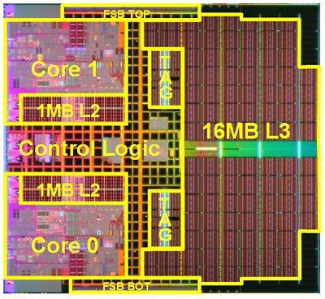
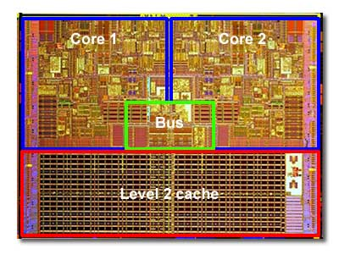
Intel Core 2 Duo (ca. 2006)
Intel Xeon “Tulsa” (ca. 2006)
Notes:
Can also have L3 cache!

Slide 20
Memory Hierarchy
Latency (nanoseconds)
Size (bytes)
Registers
~ 0
192
L1 Cache
1.1
32k
More Storage
Better Performance
L2/L3 Cache
3.3 / 7.2
256k / 2M
Random Access Memory (RAM)
63.9 - 100
2G
“Disk” Memory
Numbers based on Intel Sandy Bridge assuming 3.6 GHz CPU (ca. 2012); The Science of Computing, Victor Eijkhout

Slide 21
Memory Hierarchy
c = a + b
Registers
c
L1 Cache
L2/L3 Cache
a, b
Random Access Memory (RAM)
Notes:
So far this seems like more work
A copy at every level

Slide 22
Memory Hierarchy
Some time later…
d = 2*b + c
Registers
d
b, c
L1 Cache
L2/L3 Cache
Random Access Memory (RAM)

Slide 23
Review so far…
Processors execute instructions on data in a “fetch, execute, store” cycle.
Memory is organized as a hierarchy with data copied between levels.
Levels trade-off between storage capacity and speed.
The hierarchy makes it easier to reuse data and avoid data transfer.
Registers
For current instructions
One per CPU core
On CPU die, shared by cores
Current program instructions and data
Long-term storage; must explicitly access
L1 Cache
More Storage
L2/L3 Cache
Better Latency
Random Access Memory (RAM)
“Disk” Memory

Slide 24
Exercise
A CPU core needs to fetch data.
Thinking about the memory hierarchy, where will it first look for the data it needs?
If the data isn’t in that first location, where will it look next?
A CPU core is trying to fetch data for “y = m*x + b”. The value for “x” was just used for the most recent set of instructions and is still in the register. The variable “m” was last updated a while ago and is still in L2 cache. Variable “b” is only in RAM.
Diagram the movement (if any) of x, m, and b through the memory hierarchy.
Which levels of the memory hierarchy have a copy of variables m and b?

Slide 25
How Does Memory Work?
We’ll cover:
How information is stored in memory
How data moves through a computer (in more detail)
How we can exploit data movement for better performance

Slide 26
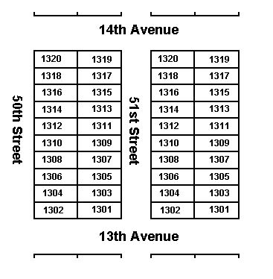
Memory Addresses
Memory is referenced with addresses, like lots on a street.
Addresses get assigned to variables, like new houses being built
“Computer Memory, Variables, Variable Types, Arrays and Structures,” Herbert J. Bernstein
http://www.bernstein-plus-sons.com/.sjcny/Computer_Memory.html
Notes:
Lot aka parcel

Slide 27
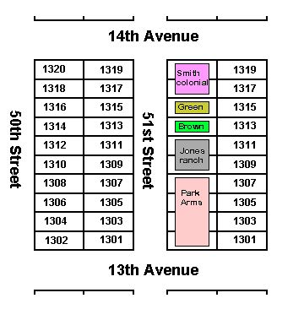
Memory Addresses
Memory is referenced with addresses, like lots on a street.
Addresses get assigned to variables, like new houses being built
Houses can be of varying sizes and even occupy multiple lots.
Variables, too, can span multiple addresses.
Variable structure is defined by its type
“Computer Memory, Variables, Variable Types, Arrays and Structures,” Herbert J. Bernstein
http://www.bernstein-plus-sons.com/.sjcny/Computer_Memory.html
Notes:
A house metaphor? In this economy??
Lot aka parcel

Slide 28
Variable
pop | houses | mv_in | mv_out | n_dogs | n_cats | n_birds | n_other
1000 | 1004 | 1008 | 1012 | 1016 | 1020 | 1024 | 1028
75 | 57 | 3 | 8 | 32 | 46 | 2 | 7
Address
Value
Notes:
Note “skip” in addresses

Slide 29
Cache Lines
Data is copied as consecutive lines of addresses, called cache lines
Variables near each other in memory are transferred at the same time
Advantage: variables we may need next already have their data available!
Notes:
Why does memory structure matter?
Example: Cache line covers 16 addresses

Slide 30
Data is copied as consecutive lines of addresses, called cache lines
Great! What’s “n_dogs”?
What’s the value for “houses”?
CPU
What happens if the CPU requests “n_cats”?
Cache
houses | mv_in | mv_out | n_dogs
57 | 3 | 8 | 32
RAM
Variable
pop | houses | mv_in | mv_out | n_dogs | n_cats | n_birds | n_other
1000 | 1004 | 1008 | 1012 | 1016 | 1020 | 1024 | 1028
75 | 57 | 3 | 8 | 32 | 46 | 2 | 7
Address
Value
Notes:
Why does memory structure matter? Caching!
Example: Cache line covers 16 addresses

Slide 31
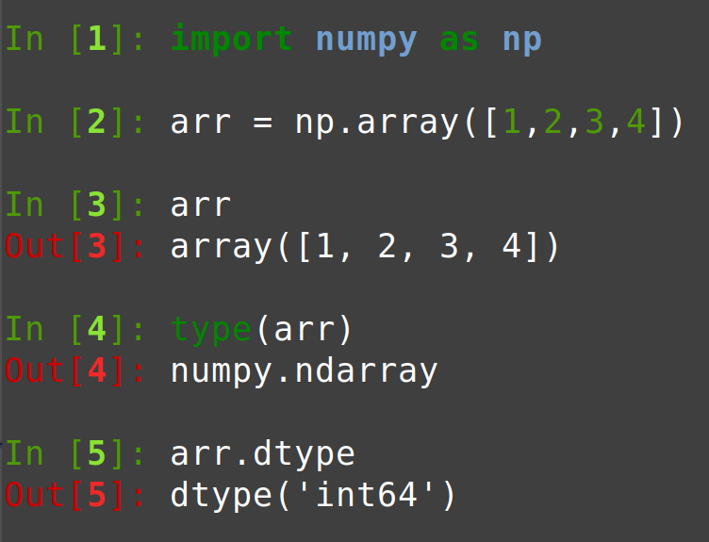
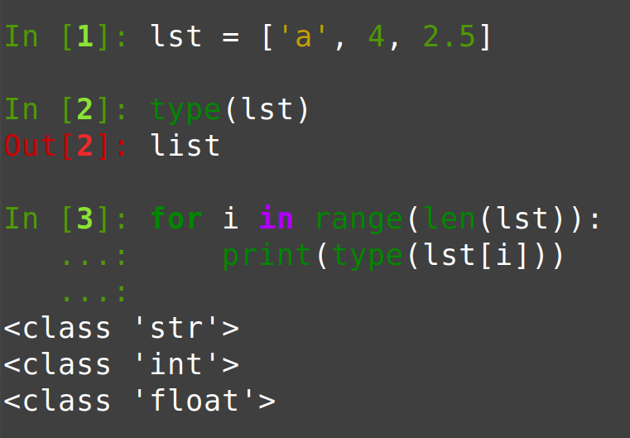
Lists, Tuples, & NumPy Arrays
These are all a form of Python “container”.
Containers are types that contain data of another type.
Array Example
List Example
Notes:
Who isn’t familiar with NumPy arrays?
Difference between tuples and lists? NumPy arrays?

Slide 32
NumPy Arrays
NumPy arrays are contiguous blocks of memory
Each block is the same size
arr = np.arange(5)
Variable
arr[0] | arr[1] | arr[2] | arr[3] | arr[4]
1112 | 1116 | 1120 | 1124 | 1128
0 | 1 | 2 | 3 | 4
Address
Evenly spaced addresses
Value

Slide 33

NumPy Arrays
Size and type must be known ahead of time to allocate memory
Type tells us how big each “house” is
Size tells us how many “houses”
Notes:
A “type” designed to hold data of other “types”

Slide 34
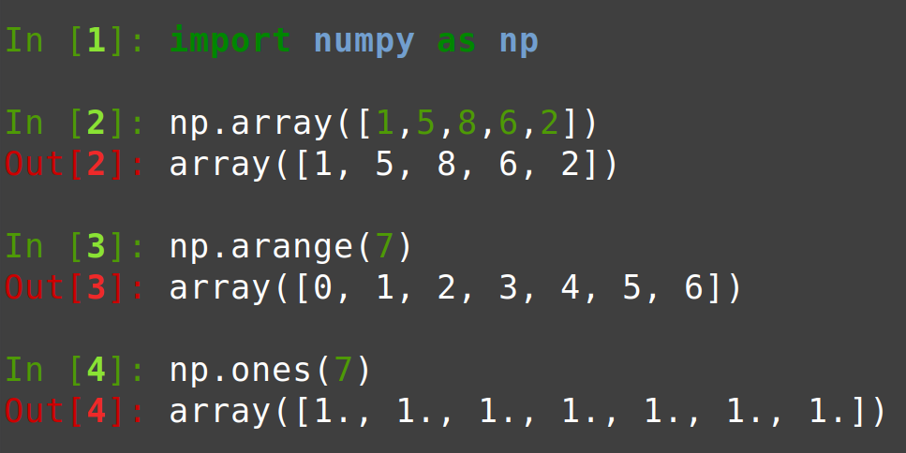
Consider these arrays…
How much memory do we need?
Enough for…
Five integers
Seven integers
Seven floats
Notes:
All approaches require size & type (even implicit)

Slide 35
NumPy Arrays & Cache Lines
The structure of NumPy arrays makes them work well with cache lines!
arr = np.arange(5)
for item in arr:
print(item)
arr[0] | arr[1] | arr[2] | arr[3] | arr[4]
1112 | 1116 | 1120 | 1124 | 1128
0 | 1 | 2 | 3 | 4
One request to RAM pulls multiple values into the cache.
We can use them one after another without additional fetches to RAM.
Notes:
Request one variable, get a line

Slide 36
Lists
Lists are also contiguous blocks of memory
But lists can hold objects of any type, including other lists!
Memory blocks are not the same size
lst = [“a”, 4, 2.5, “c”]
Variable
lst[0] | lst[1] | lst[2] | lst[3]
1300 | 1302 | 1306 | 1314
“a” | 4 | 2.5 | “c”
If lists worked like arrays:
Address*
Value
* I made up the size of each block
Notes:
Computers don’t handle this well!

Slide 37
Pointers
Lists instead rely on pointers.
Pointers are a special type of variable whose value is the address of another variable somewhere else in memory
Variable
my_pointer
1001
3256
<no name>
3256
“hello”
Address
Value
Notes:
Familiar for C/C++
Under the hood in Python (implemented in C)

Slide 38
How lists really work
lst = [“a”, 4, 2.5, “c”]
Variable
lst[0] | lst[1] | lst[2] | lst[3]
1300 | 1302 | 1304 | 1306
1624 | 2986 | 3210 | 3244
Address
Evenly spaced addresses :)
Value
Address of actual data
<no name>
1624
“a”
<no name>
2986
4
<no name>
3210
2.5
<no name>
3244
“c”
Notes:
Think: an array of pointers
Super flexible!

Slide 39
Arrays vs Lists - Accessing Data
arr = np.arange(5)
print(arr[0])
lst = [“a”, 4, 2.5, “c”] print(lst[0])
Array entries are desired data
Fetch arr[0]
It’s our data! Print.
List entries are actually pointers; Data lives elsewhere
Fetch lst[0]
It’s a pointer! Dereference.
Fetch address saved to pointer lst[0]
It’s our data! Print.
Notes:
Keep this up while pivoting to diagramming exercises.
Which has greater cache reuse?

Slide 40
Review
Processors execute instructions on data in a “fetch, execute, store” cycle.
Memory is organized as a hierarchy
Balances speed and capacity
Data is transferred through the hierarchy as consecutive blocks called “cache lines”
Let’s us fetch data before we need it, if we’re clever
Variables are values associated with a memory address
A pointer is a special data type whose value is another address

